Slide 1



Teaching Problem Solving
Fred Nickols
A Webinar for Faculty at University of Arkansas, Pine Bluff
April 30, 2020

Slide 2

Overview
Dr. Ann Michael story
Knowledge Transmission model
Problem solving in the context of learning
Advice from experts
Specific recommendations
Examples of assignments
Acknowledge ideas from IDEAL Problem Solver, Chapter 8

Slide 3

Dr. Ann Michael
Practicum in Language Therapy for Language-Delayed Children
Students not using knowledge from prerequisite Theories of Language and Implications for Therapy
Assumed prerequisite taught poorly
Later, Dr. Michael taught both classes
Students passed her Theories class, mastered knowledge
Two years later, same students didn’t apply Theories during Practicum

Slide 4

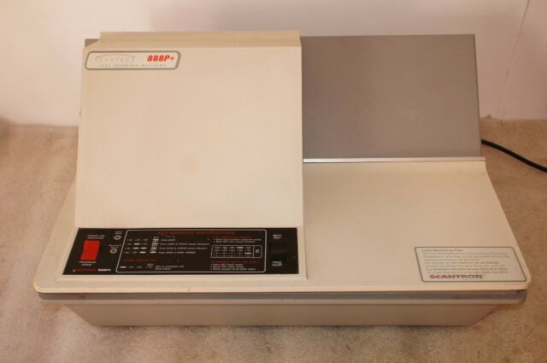
Q: Why don’t students solve problems with knowledge they learn?
A: We teach them inert knowledge
  Inert: without power to move
Example… Senior Comprehensive Exams with multiple choice questions.
Does this demonstrate to a department what students can create with the knowledge, skills and competencies in the discipline?

Slide 5
Knowledge Transmission Model of Instruction
“I can’t give a problem solving assignment until late in the semester, because students have to know something about the subject first.”
TM – teach knowledge first, then teach application of knowledge to a problem
Read chapter, listen to lecture, do homework problems at the end of the chapter.
What’s wrong with that?

Slide 6

Problems with application problems
Not real-world problems with real-world constraints
Example:
The fourth grade at Smith Elementary School has 168 students and 7 teachers. The fourth grade is going on a field trip and will require school buses for transportation. A school bus carries 72 passengers. How many buses will be needed?

Slide 7
Problems with application problems
Not real-world problems with real-world constraints
Example:
The fourth grade at Smith Elementary School has 168 students and 7 teachers. The fourth grade is going on a field trip and will require school buses for transportation. A school bus carries 72 passengers. How many buses will be needed?
Answer: 2.43 buses… Nope, 3 buses, because you can’t take students on a field trip in a fraction of a bus.

Slide 8

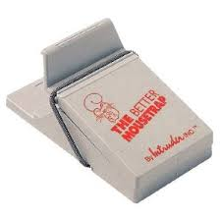

Problems with application problems
Problems have one right answer, real-world problems have multiple possible solutions.
Do you assign even problems, because answers to odd problems in back of book?

Slide 9


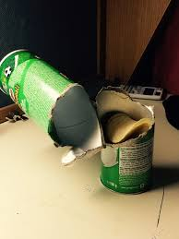
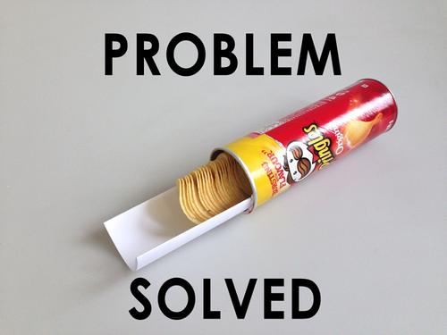
Problems with application problems
Approach needed to solve the application problem is in the chapter they just read.
Students don’t learn to generate creative approaches, evaluate, and choose the best.

Slide 10
Questions

Slide 11
How should we teach Problem Solving
Review of expert opinions…
  Books
  Articles
  Internet

Slide 12
How should we teach Problem Solving
Introduce students to a different Problem Solving models
Teach problem solving in the context of learning
Give students guidance/feedback along the way through formative/summative assessments
Case-based instruction
Project-based instruction
Model problem solving for the student
Teach students that problems don't usually have just one solution
Debates as anchors for learning
Challenge debates
Simulations using computer technology
Identify types of problems (routine vs nonroutine) well-structured, ill-structured
Jigsaw - Teach breaking complex problems into component parts
Teach critical thinking, this makes students better problem solvers
Reflection Assignments
Help students learn to define the problem/question
Get terminology straight
Teach students that problems can't always be solved the first time (teach grit)

Slide 13
How should we teach Problem Solving

Slide 14
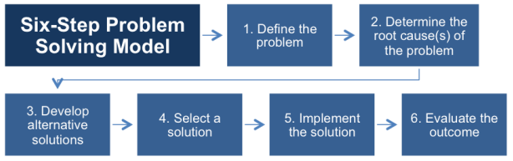
Introduce Different Problem Solving Models

Slide 15
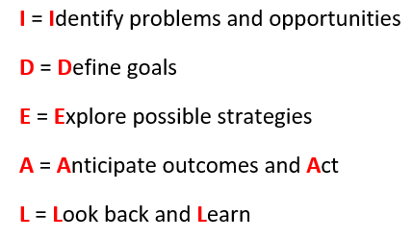
Introduce Different Problem Solving Models

Slide 16
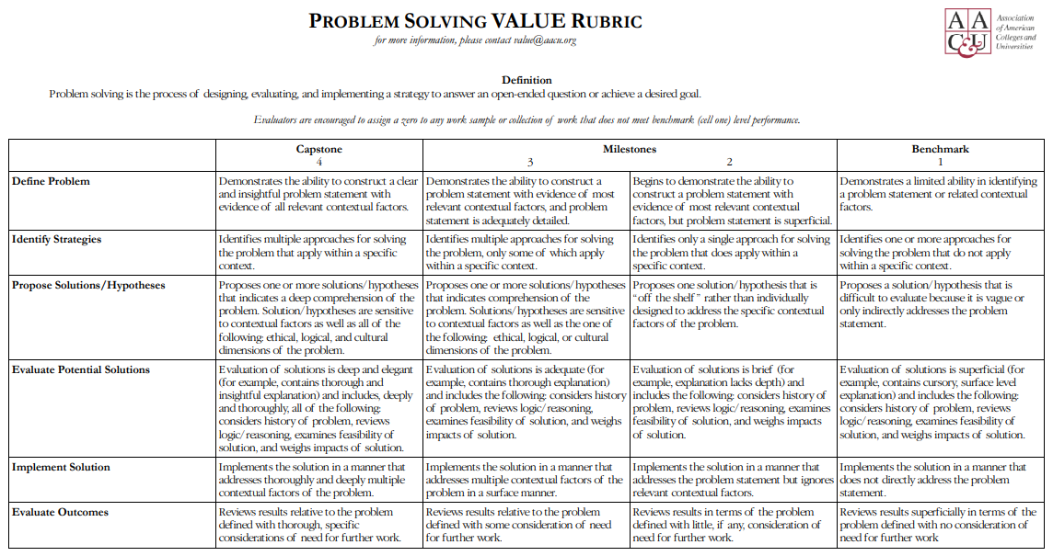
Introduce Different Problem Solving Models

Slide 17


Problem Solving in the Context of Learning
Case-based learning
  Brian Murphy

Slide 18


Problem Solving in the Context of Learning
Case-based learning
Project-based learning
  Supply Chain UAF
  bigger warehouses or more warehouses

Slide 19

Problem Solving in the Context of Learning
Case-based learning
Project-based learning
Challenge debates
  https://www.qub.ac.uk/International/global-challenge-debates/

Slide 20
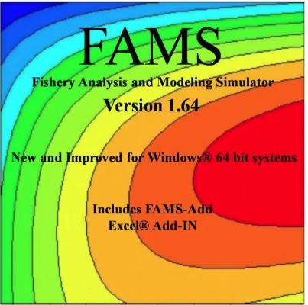
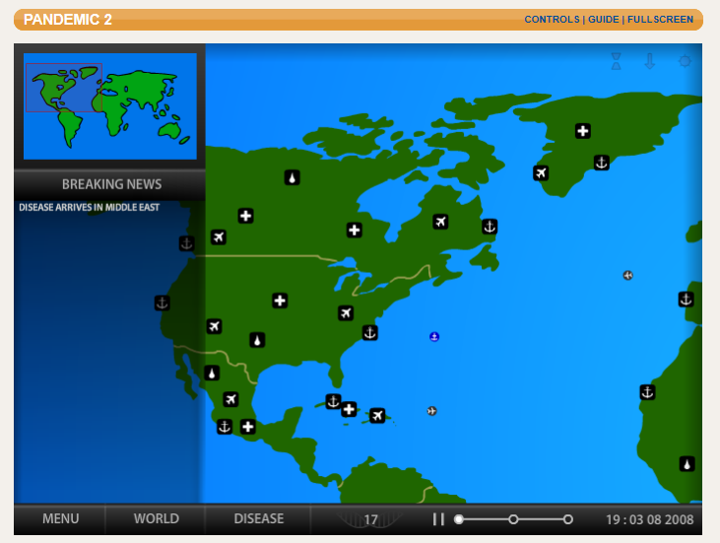

Problem Solving in the Context of Learning
Case-based learning
Project-based learning
Challenge debates
Simulations

Slide 21

Feedback through formative assessments
Blindfolded man learning to draw a 4-inch line
Self-assessments, peer-assessments
LiveText can do formative assessments

Slide 22
Questions

Slide 23
Examples of Assignments
Early in the Semester
http://www.uapb.edu/Uploads/Files/Downloads/Early in the Semester Generic Problem Solving Assignment_03.pdf

Slide 24
Examples of Assignments
Early in the Semester
http://www.uapb.edu/Uploads/Files/Downloads/Early in the Semester Generic Problem Solving Assignment_03.pdf
Midterm Dilemma
http://www.uapb.edu/Uploads/Files/Downloads/Mid Term Challenge Problem Solving Exercise_01.pdf

Slide 25
Examples of Assignments
Early in the Semester
http://www.uapb.edu/Uploads/Files/Downloads/Early in the Semester Generic Problem Solving Assignment_03.pdf
Midterm Dilemma
http://www.uapb.edu/Uploads/Files/Downloads/Mid Term Challenge Problem Solving Exercise_01.pdf
Wicked Problems
http://www.uapb.edu/Uploads/Files/Downloads/Example of generic assignment for Problem Solving_02.pdf

Slide 26
Wrap Up Discussion

Slide 27
Please do evaluation…

Slide 28
Contact Information
Fred Nickols
Managing Partner
Distance Consulting, LLC
“Assistance at a Distance”
922 Country Club Drive
Howard, OH 43028
fred@nickols.us
www.nickols.us
(740) 504-0000
“My Objective is to Help You Achieve Yours”

